Slide 1


Fetal Health Project

Slide 2
TABLE OF CONTENTS
01
03
02
04
INTRODUCTION
RESULT
METHODS
CONCLUSION

Slide 3
INTRODUCTION
We have made a study about fetal health classification based on many factors like (Baseline Fetal Heart Rate, Number of accelerations per second, Number of fetal movements per second, uterine contractions).

Slide 4
Target
Y
X
( Fetal health ) = Normal Suspect, Pathological.
Features X = 21 columns

Slide 5
02
Visualizing
Evaluate
Load data
Data Pre-processing
Modeling

Slide 6
Tools :
1
2
Jupyter Notebook
Python Libraries

Slide 7
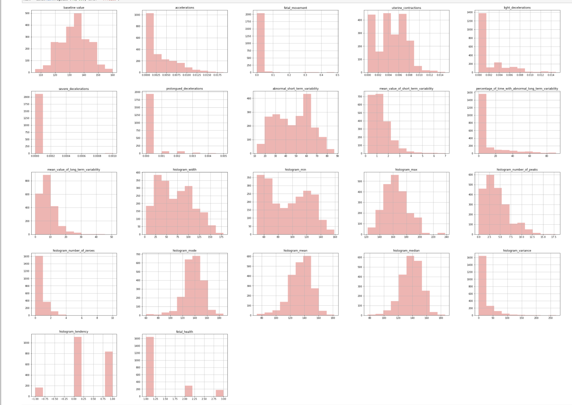
All Columns

Slide 8
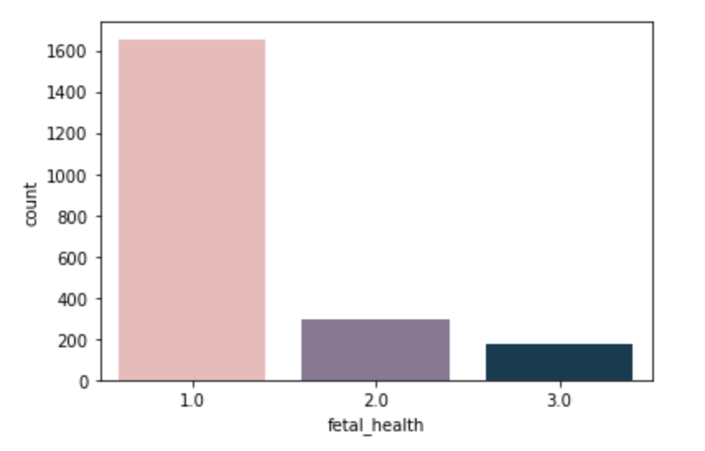
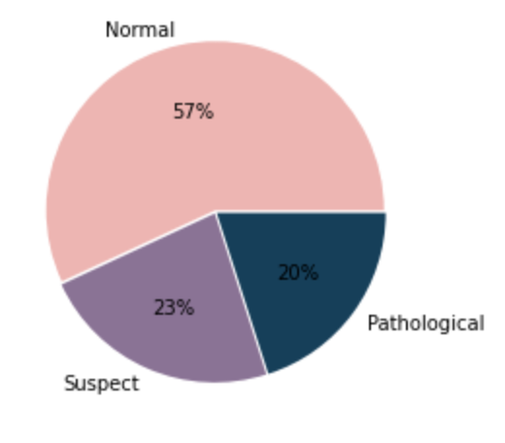
1
2
Pie Chart of Fetal Heath
The Target "fetal_health”

Slide 9
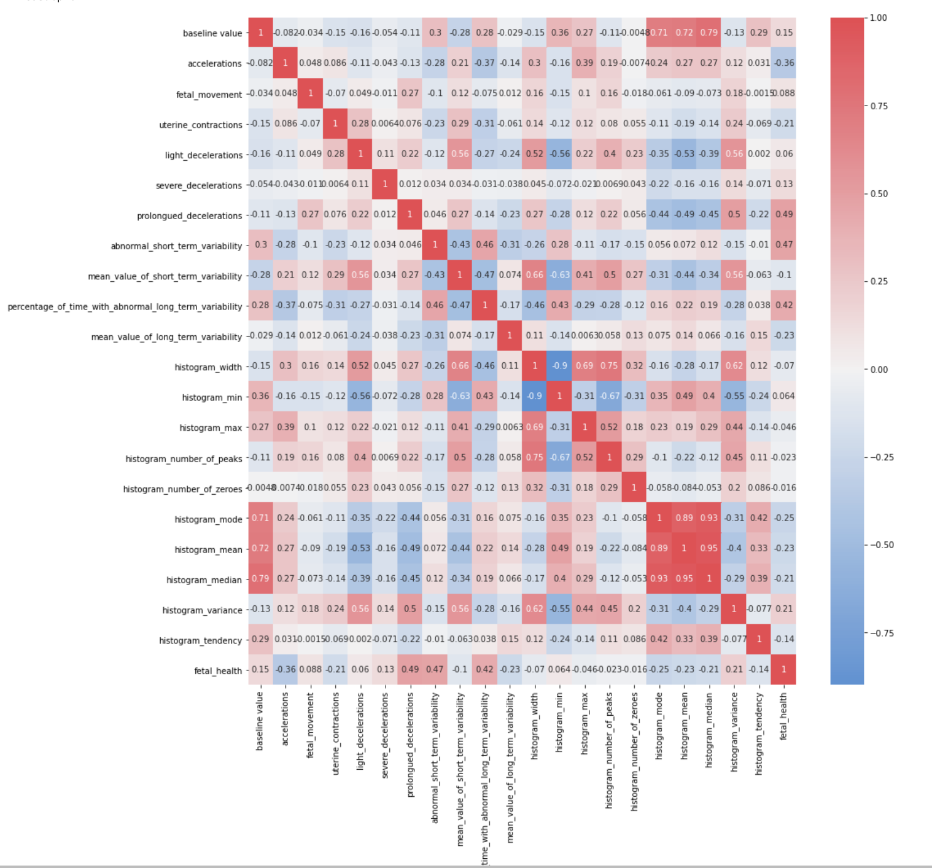
Correlation Matrix

Slide 10
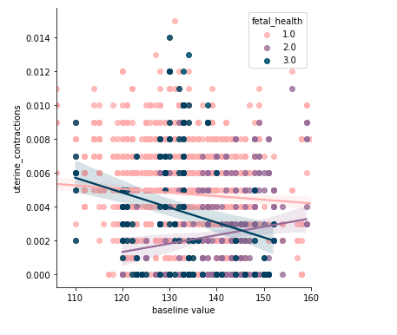
Relationship between Baseline Fetal Heart Rate and Uterine Contractions

Slide 11
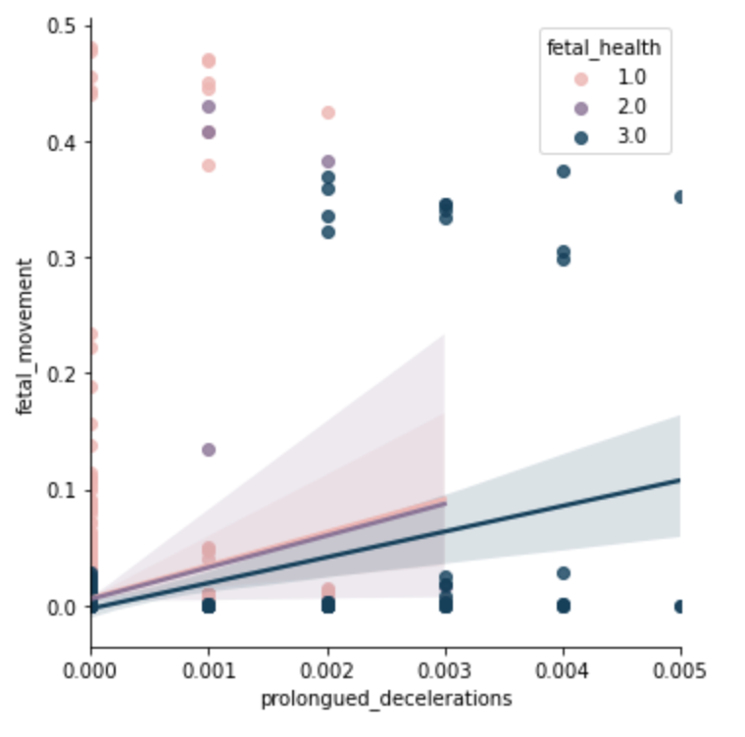
Prologued Decelerations Vs Fetal Movement by Fetal Health:

Slide 12
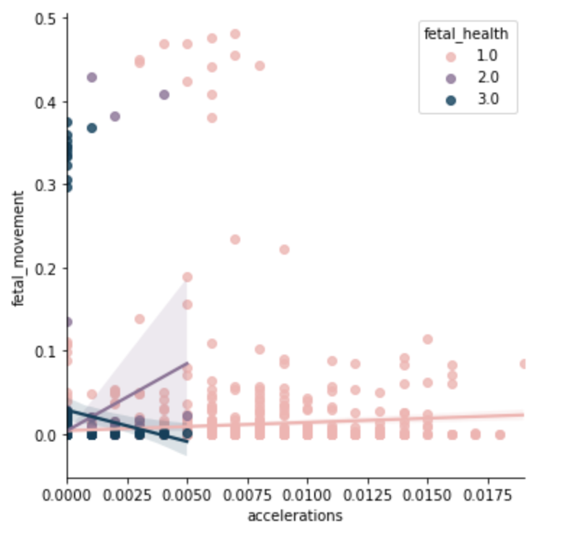
Accelerations Vs Fetal Movement by Fetal Health :

Slide 13
MODELING
01
03
02
Logistic Regression
KNN
Random Forest
Modeling :

Slide 14
Modeling :
Model | Accuracy | MAE | MSE | RMSE | R^2 | Recall | Precesion | F1 Score | ROC
Logistic regression | 0.924 | 0.080 | 0.089 | 0.299 | 0.755 | 0.924 | 0.92271 | 0.92434 | 0.977
Random forest | 0.957 | 0.047 | 0.056 | 0.238 | 0.845 | 0.957 | 0.956 | 0.957 | 0.984
KNN | 0.929 | 0.075 | 0.085 | 0.291 | 0.768 | 0.929 | 0.933 | 0.929 | 0.948

Slide 15
MODELING
01
03
Logistic Regression
02
KNN
Random Forest
confusion Matrix

Slide 16
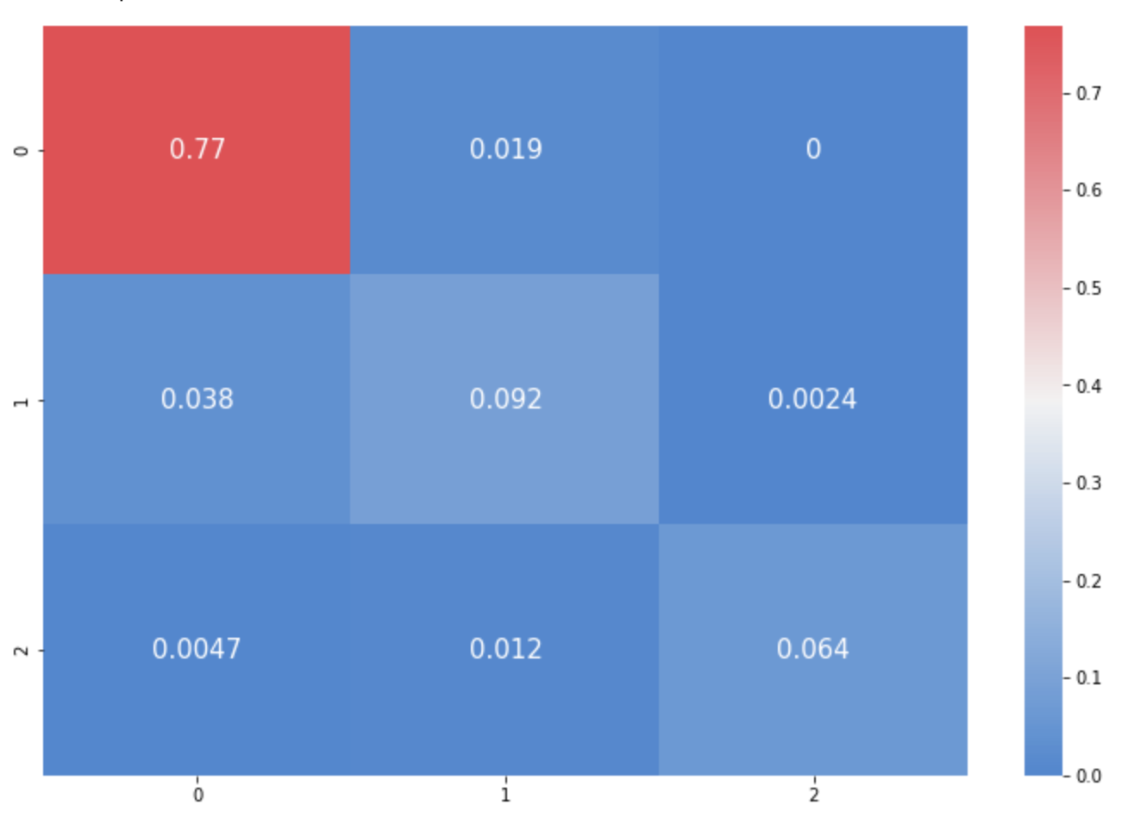
Confusion Matrix: Logistic Regression

Slide 17

Confusion Matrix: Random Forest

Slide 18
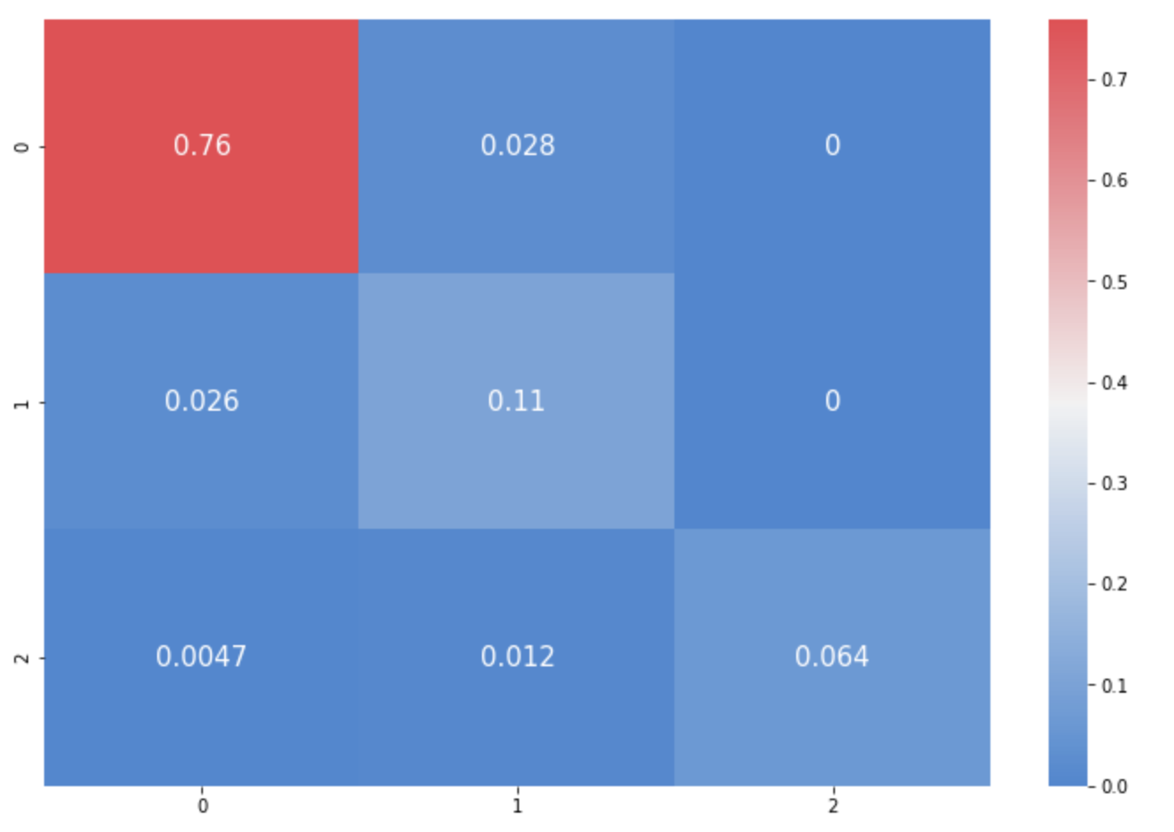
Confusion Matrix: KNN

Slide 19
MODELING
01
03
Logistic Regression
02
KNN
Random Forest
ROC

Slide 20
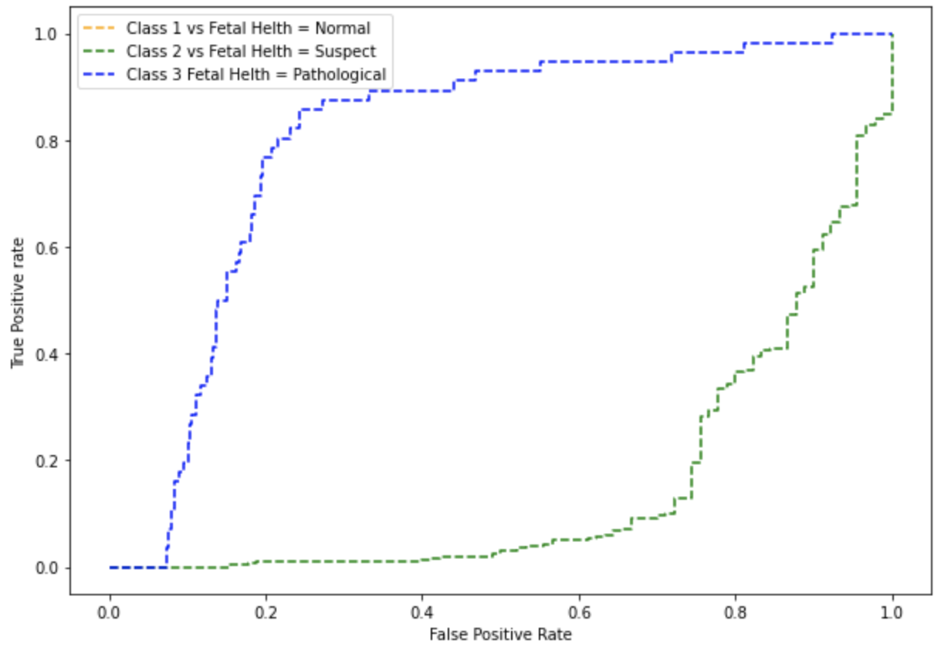
ROC: Logistic Regression

Slide 21
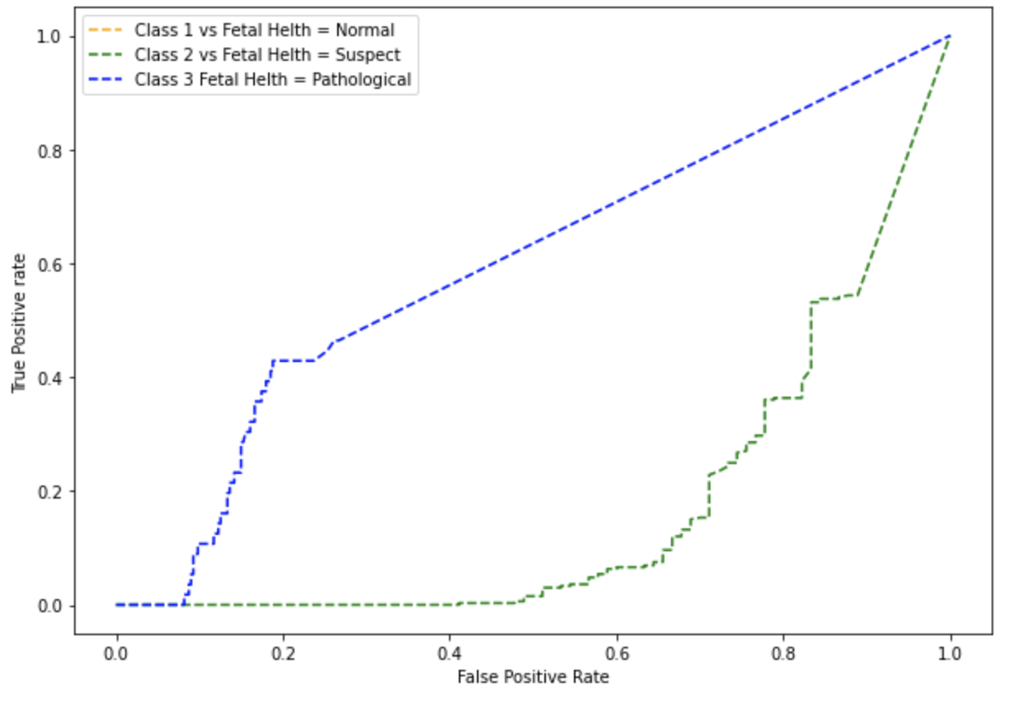
ROC: Random Forest

Slide 22
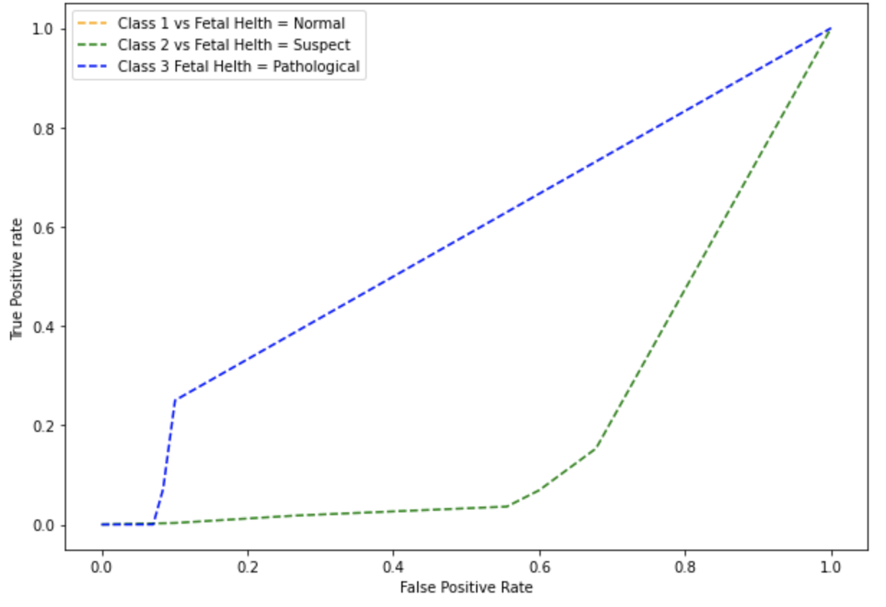
ROC: KNN

Slide 23


Conclusion :
At the end..
Random forest model is the best acuracy ..

Slide 24
Do you have any questions?
THANKS
Name
Nada Alqabbani
Shahad Almubki
Nada Alhamad
Sarah Alameer
Hala Almulhim
Instructor:
Mohammed Bddar

